Slide 1

Basics of HPC for researchers
IAP Activity 2022

Slide 2
Who is this class for ?
Compute plays a support role in your research and:
  Compute is a bottleneck that impact the pace at which you can conduct research OR
  There are problems that seem currently out of reach but would benefit your field if they could be solved

Slide 3
Who is this class NOT for ?
Producing high performance implementation is the main focus of your research
You wish to understand in depth systems involved in HPC applications
Learn all the good practices about:
  Code management
  Testing
  Deployment
  ...

Slide 4
Course organization
One time slot per day (2-4 pm) from Monday to Friday (incl.)
Focus on the main avenues one can leverage to improve their implementations (~ 1 per day)
Once we are done with the material:
  Talk about some concrete examples (ideally from your research)
  Go through some pre-planned examples
  Or call it a day
  I will stay as long as there are people left to talk about questions about the class or some the compute challenges you are facing

Slide 5
Course organization
Not for credit this year
If you have a good time make sure you review so that it can become for credit in the future
This would give us funding to provide grading for some problem sets

Slide 6
Course plan
1
Implementation improvements
Same instructions
Same hardware
Same data
But faster

Slide 7
Course plan
2
Improved data management
Same instructions
Same hardware
Our compute is not waiting on data to arrive
Our data is structured efficiently

Slide 8
Course plan
3
Algorithmic improvements
Find alternative strategies to achieve our goal
Transform our problem into standard problems and leverage existing implementations

Slide 9
Course plan
4
Parallelism
Aka. throw more resources at the problem
Multiple cores
CUDA
Multiple machines
  MPI
  DASK

Slide 10
Personal Introduction
Let’s all introduce ourselves
  Optional
  Talk about your field and how you usually apply compute
  Talk about some of the topics you are excited about
  Talk about the ones you think you already know
I’ll start

Slide 11
Lecture 0:
When, How and What to optimize ?

Slide 12
Golden Rule 1
“The real problem is that programmers have spent far too much time worrying about efficiency in the wrong places and at the wrong times; premature optimization is the root of all evil (or at least most of it) in programming.”
-- Donald Knuth,
The Art of Computer Programming

Slide 13
Golden Rule 1
Your goal is to save time
Always asks yourself:
  How fast can this be done ?
  How many time do I need to run this ?
  How long is it going to take me to optimize (and double it) ?
If this doesn’t yield a significant saving, skip it!

Slide 14
Golden Rule 1
Especilly true for Pre-processing/Data ingestion tasks
It doesn’t mean you can’t already use proper data magament practices to get a head start on making you code fast for later stages of compute

Slide 15
Golden Rule 2
„I'm not going to worry about the scalability of my solution until I have a solution that works.“
-- Rich Hickey

Slide 16
Golden Rule 2
Always start with the most trivial, short, less likely to go wrong solution
Test it on some inputs and really convince yourself that it is correct.
Save it in a known place (git or other VC is best)
Every time you implement an optimization compare the outputs of the fast one to the correct one!

Slide 17
Golden Rule 2
Optimizing code is like building a wall:
  Every brick is applying a technique (from simple to advanced) to make your code slightly faster
  If you place one wrong anything you build on top is a wast of time
  Your (slow) reference implementation is your foundation. You won’t be able to tell if your wall is straight and square if you don’t trust it.

Slide 18
Golden Rule 3
„The first rule of optimization is don't do it. The second rule of optimization is don't do it yet. And the third rule is, if you must do it, start with the right machine.“
-- Michael A. Jackson (?)
„You will get a second machine when you know how to use the first one properly“
-- EPFL’s MATH-454 instructor

Slide 19
Golden Rule 3
Parallelism is the last resort
How many machines can you use ?
Am I hurting fellow researchers by using ridiculous amounts of resources ?
The absolute best you can hope is linear speedup with the number of machines
You can and will be faster by just making your code better
From personal experience: 20-30x is the most common and it can go beyond 100x. Prallelism is just the icing on the cake.

Slide 20
Part 1: Understanding the machine

Slide 21
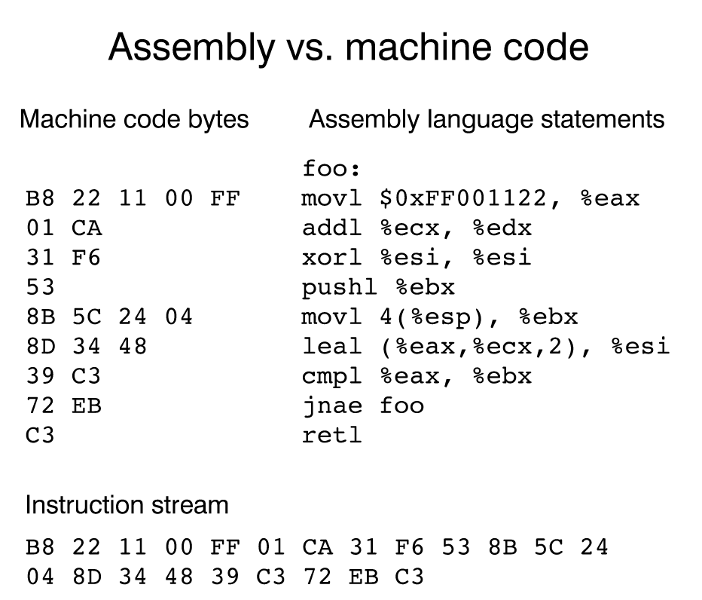
The classic CPU core
Much simpler than one expects
Only understands a single programing language
Can only run a single instruction at a time
[https://www.nayuki.io/res/a-fundamental-introduction-to-x86-assembly-programming]

Slide 22
The classic CPU core
Can only handle very few variables: 32 x 64bits on your laptop
You would need 5 millions CPU cores to handle 1GB of data.

Slide 23
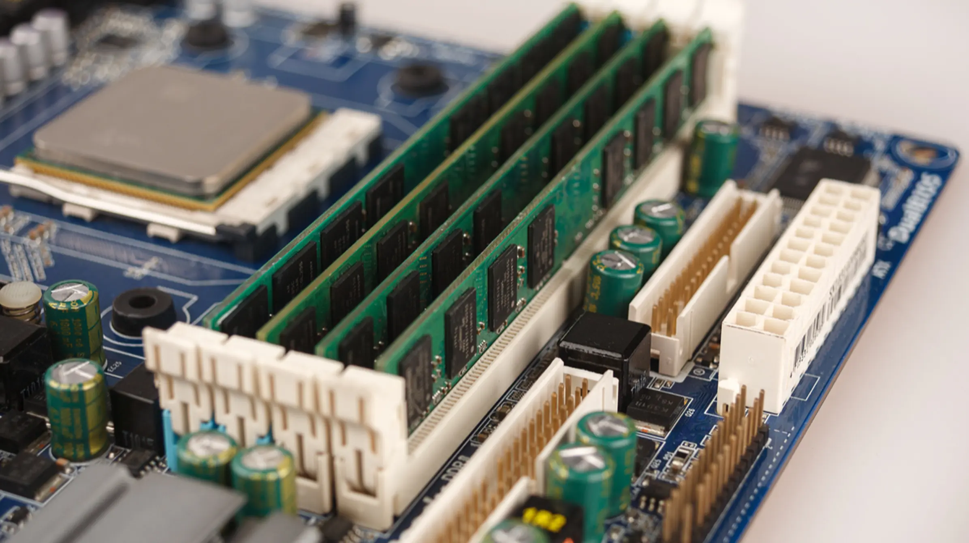
RAM to the rescue
We essentially have no storage in the CPU core. So we have to put our data somewhere else.
At the scale of modern computers the distance between RAM and the CPU is significant!
For this reason (and others)
it is much slower to access
Can you guess by how much ?
x20

Slide 24
How to overcome the issue
Try to guess first!
This is one of the most recurrent concepts in computer architecture
If it takes a „long“ time to transport data between two locations: do it in bulk!
Speed of light limits how fast you can move something but it doesn’t stop you from sending a lot at once.

Slide 25
Implications on programming
When you need data that isn’t stored on the processor, you will have to wait a long time.
When you get data back from RAM, you will get more than you need. If you plan a little you can take advantage of this extra data and skip most of the waiting times
While your code waits on RAM, the core is twiddling its thumbs so manufacturers tried to avoid this waste
  Multi-threading
  Out of order execution

Slide 26
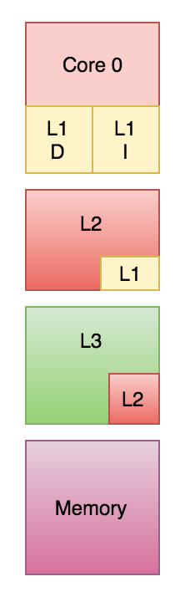
Can we do better: Caches
Registers (local variables inside the core) are crazy fast but minuscules
RAM is large but far away
Caches are a compromise
Different levels with increasing sizes and slower speeds
  Bigger one take more space and have to be further away
  It takes longer to search a larger pool of data than a small one

Slide 27
Example
cpu_cache_notebook

Slide 28
Beyond RAM: Secondary Storage
What if I need permament storage ?
What if I need to store more than the amount of RAM I have ?
This is called secondary storage and includes
  SSDs
  HDDs
  Network attached storage
  Tapes

Slide 29
Secondary Storage
Physically further than RAM
Storing/reading permanent data is much slower
Can you guess how much slower it is to get an answer from RAM vs an SSD ?
x25.000

Slide 30
Latency isn’t everything
We saw that how long it takes to retrieve data varies wildly in function of where it is stored.
We also talked that we can mitigate latency by transporting more data at once
This is bandwidth
It’s therefore important to know:
  Latency of a device
  The bandwidth
  What is required to do to achieve the maximum bandwidth

Slide 31
Summary Table
Storage | Latency | Bandwidth | „Block“ size | Total Size
Registers | < 0.3ns | N.A. | 8B | 256B
L1 Cache | ~1ns | 80GB/s | 64B | 64KB
L2 Cache | ~3ns | 40GB/s | 64B | 512KB
L3 Cache | ~20ns | 25GB/s | 64B | 128MB
RAM | ~30ns | 20GB/s | 64B | 500GB
SSD | 250us | 3GB/s | 8KB | 2TB
HDD | 1ms | 100MB/s | 8KB | 16TB

Slide 32
How to program the machine ?

Slide 33
Programming
We need to generate instructions (a program) that our machine knows how to execute
We saw earlier that CPU cores only understand a very rudimentary languge
The languge is machine specific!
Your phone and your laptop don’t even speak the same language

Slide 34
Alternative 1: Writing assembly
There exists a 1-to-1 mapping between assembly and machine code
Still very hard to decypher
With good knowledge of the machine and in certain situations this will lead the the fastest implementations
Will not be transferrable to another machine
Usually reserved to experts
Usually limited to very small sections of critical code.

Slide 35
Alternative 2: Compiled languages
A designer defines the structure and features of a language
Writes a program that takes a piece of code in the language defined in step 1) and convert it into machine code
The machine code is executed
C, C++, Haskell

Slide 36
Alternative 2: Compiled languages
More convenient than assembly
Can apply “optimizations” during the transformation to machine code
Compilation can take a significant amount of time
Compilers can sometime generate inefficient code

Slide 37
Alternative 3: Interpreted languages
A designer defines the structure and features of a language
Write a programs that “interprets” the language:
  Read the program line by line
  Runs a sequence of machine instructions that “emulates” the instruction of the human readable language
  Moves to the next one
Python, JavaScript, R

Slide 38
Alternative 3: Interpreted languages
Usually easier to write programs for
Can be ported to other machines (as long as an interpreter was written for this language/machine pair
No time spent compiling
Starts immediately
Are sometimes orders of magnitude slower than compiled languages
Cannot apply any optimizations as it doesn’t see the “big picture” (each line is processed one at a time)

Slide 39
Alternative 4: Hybrids
A complex, easy to understand by humans language is compiled into a lower level language
These lower level instructions are then interpreted
Portable
Faster than interpreted
Slower than compiled
Java, WebAssembly

Slide 40
Alternative 5: Just in time compiled
Functions are compiled only when they are needed
Functions are compiled differently for every data types (machine code to add two integers or two decimal numbers are different)
Julia

Slide 41
Alternative 5: Just in time compiled
Can generate code as efficient as compiled languages
Starts immediately without the need for lengthy compilation process
Execution can be jittery (pauses from time to time when compilation is required)
Compilation happens at every execution vs once and for all for compiled languages

Slide 42
Part 2:
Diagnostic thechniques

Slide 43
Remember the rules
You have a basic implementation
You didn’t do any optimizations on it
You ensured that it is correct and have a way to test if any modifications breaks it

Slide 44
Profiling
A profiler is a tool that runs your program and tells you:
  Where was the time spent
  How many time a function was called
  And in some cases how long did a given line of code took
This is the second tool you should learn when picking up a new programming language (after the debugger)
This is another good reason why decomposing your code into functions and properly name them is important.

Slide 45
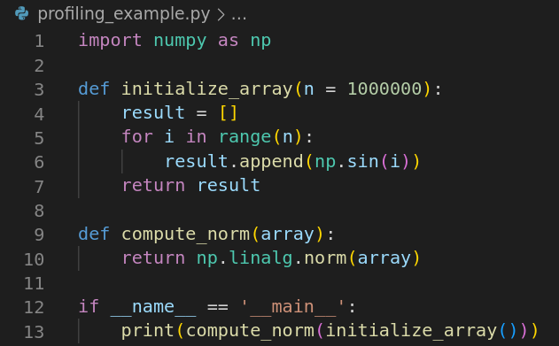
Example 1

Slide 46
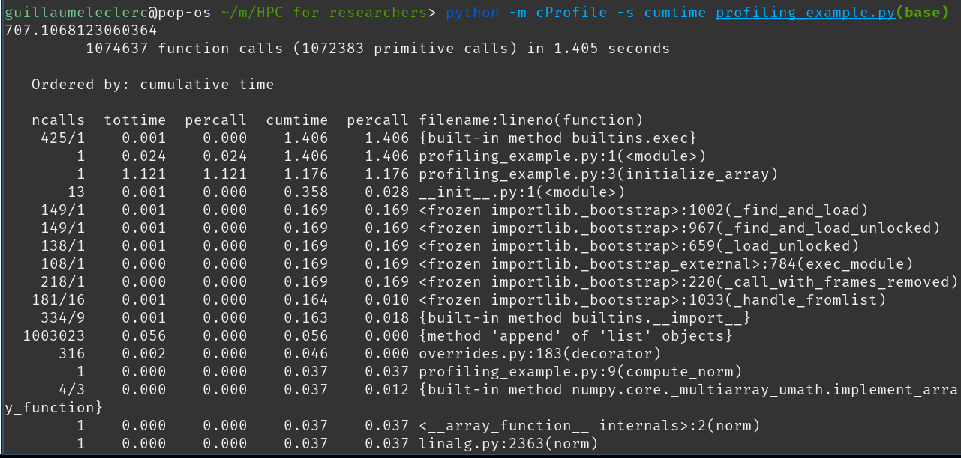
Exmple 1

Slide 47
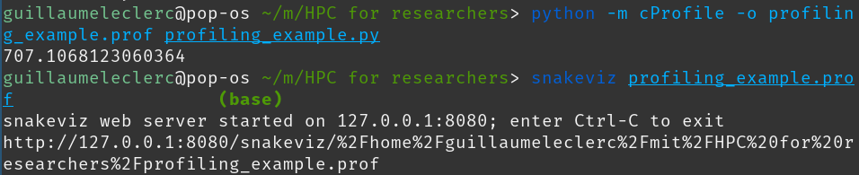
Exmple 1

Slide 48
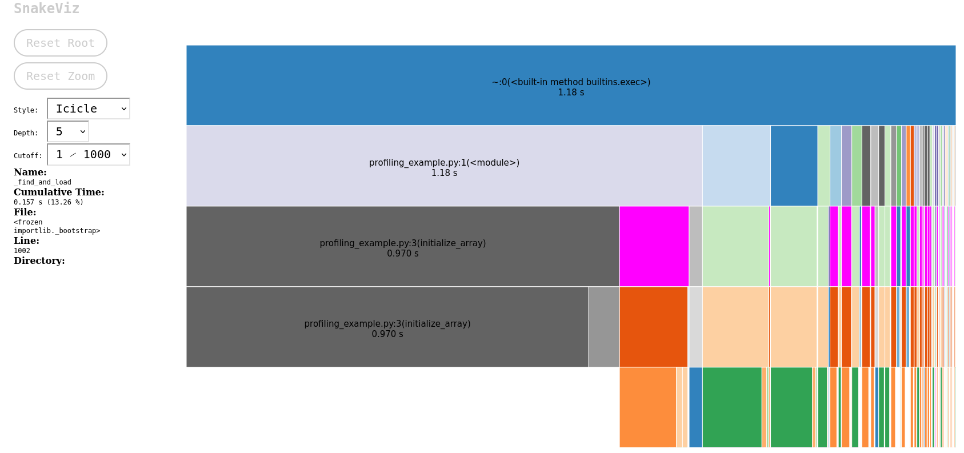
Exmple 1

Slide 49
Example
profiling_notebook

Slide 50
Random Tips 1
If your function has an input with variable size input (array, matrix). Try to understand how runtime evolves over time.
This can be done by simply analyzing the code but most methods only care about asymptotic performance
In many practical applications this is irrelevant.

Slide 51
Random Tips 2
Before profiling decompose your code as much as possible.
Example: As a pipeline of operations
This will give you a better idea of what is slow and you can focus your energy when profiling (profiling entire projects can take a long time)

Slide 52
Profiling types
Two main families:
  Instrumenting profilers
  Sampling profilers

Slide 53
Profiling types: sampling
Sampling is the most popular approach
  Pauses the program at regular intervals and take note of where it is
  Minor slowdown
  Will „miss“ very short events

Slide 54
Profiling types: Instrumenting
Modifies the code to insert instructions that track time and resources
More accurate
Drastically increase runtime

Slide 55
Profiling: going further
If you use any other language, make sure you are aware of good-ish tools to profile.
Profiling is a very broad topic, and there are many advanced measurements one can make passed the number of function calls and how long they took.
As you learn more about the general architecture of computers and how they can potentially impact performance , make sure you learn appropriate tools.

